Slide 1


React JS
Router, Event, CSS, Context, Ref, Build

Slide 2
Table of Contents
React JS 3
Events
Form
Router
Context
Ref
CSS
Build

Slide 3
Router
React JS 3
Installation:
npm install react-router-dom to get Router and Elements
Keywords:
Wrap all the Routing elements in Routes
Route to decide which component to render for which path
Link or NavLink for navigation
Wrap entire application code in BrowserRouter
Navigate to redirect to another path

Slide 4
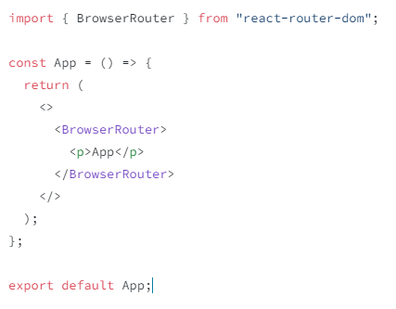
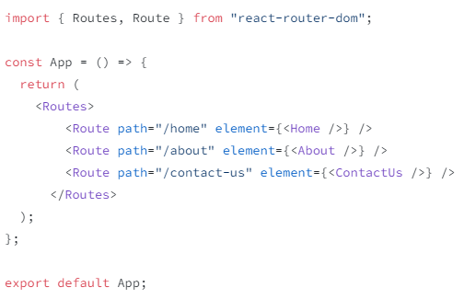
Router - Usage
React JS 3
1) BrowserRouter
2) Routes, Route

Slide 5
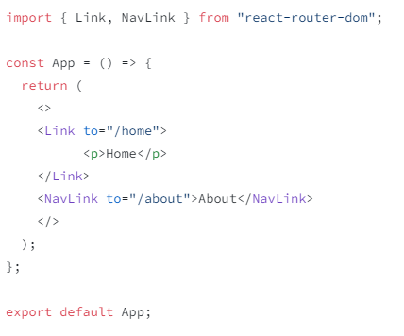
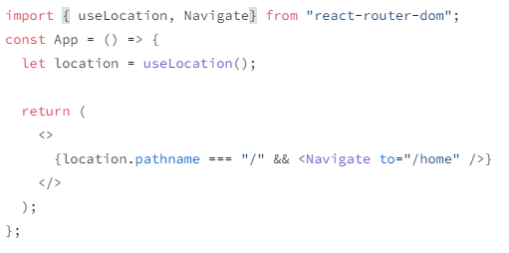
Router - Usage
React JS 3
3) Llink, NavLink
4) Navigate, useLocation

Slide 6
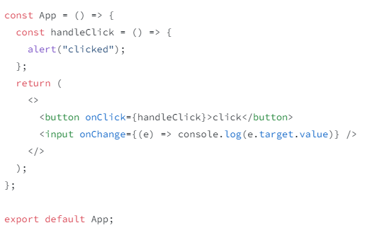
Event
React JS 3

Slide 7
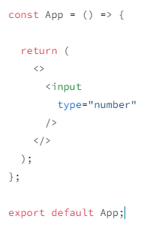
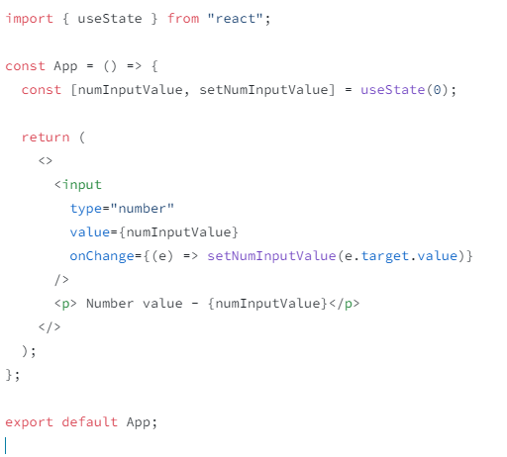
Input
React JS 3
1) Uncontrolled Input
2) Controlled Input

Slide 8
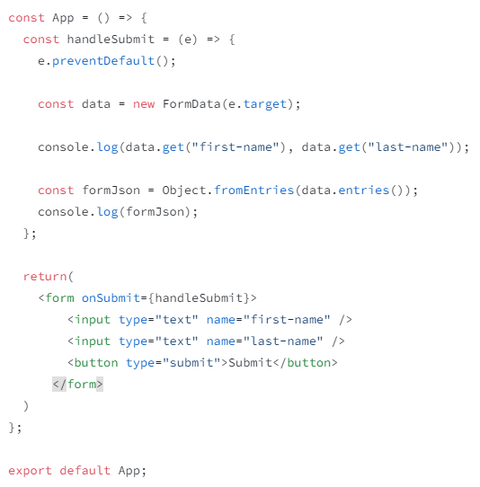
Forms
React JS 3
‘onSubmit’ event is used to submit form data
We can access the data using ‘FormData’

Slide 9
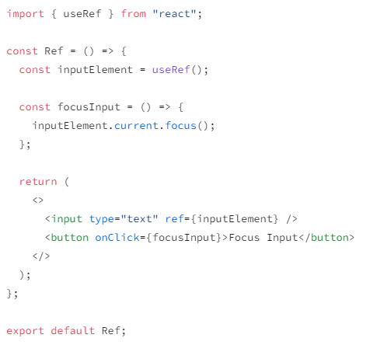
Ref
React JS 3
When you want a component to “remember” some information, but you don’t want that information to trigger new renders, you can use a ref.
The value is preserved between renders
Example: We can use it to access DOM elements

Slide 10
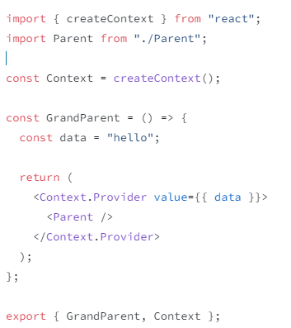
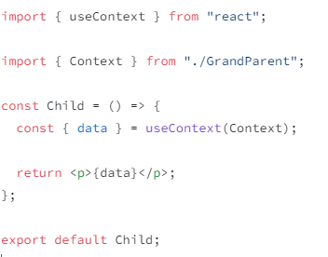
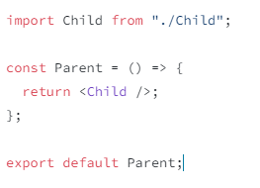
Context
React JS 3
To pass data from one component to another through many components in the middle
Create context using ‘createContext’ and pass the data using ‘Provider’. Export the context along with the component
Import the context and retrieve the data using ‘useContext’

Slide 11
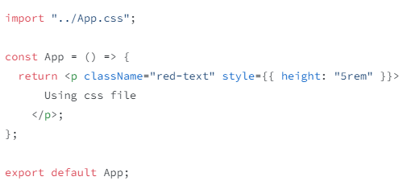
CSS
React JS 3

Slide 12
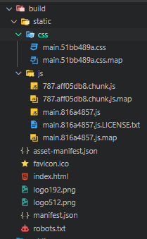
Build
React JS 3
npm run build
We will get the production build in build folder
We can then host/serve it

Slide 13


Any Questions

Slide 14
Knowledge Check
React JS 3
Router components
Types of input
How to get form data
How to use ref?
Context components
Lastly
Can we directly run build html?

Slide 15
Thank You
qcautomation@meditab.com axes.meditab.in

